Slide 1


Slide 2
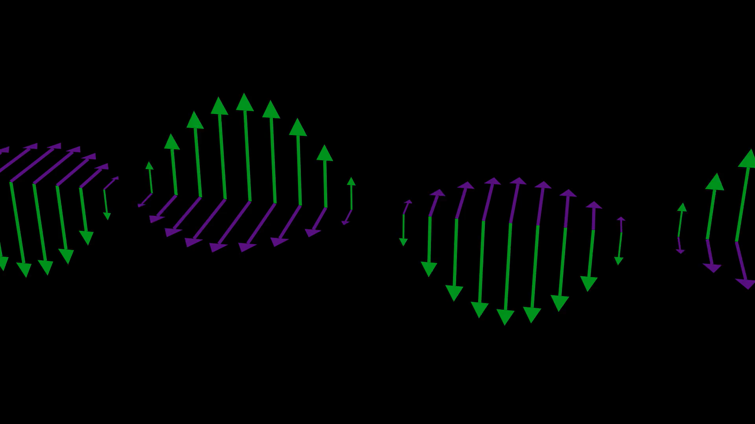
What is Manim?
Manim is a Python library for programmatic animations
Made by 3Blue1Brown
Good for repetitive or recursive animations
L
JustAnotherPhysicist, r/Manim

Slide 3
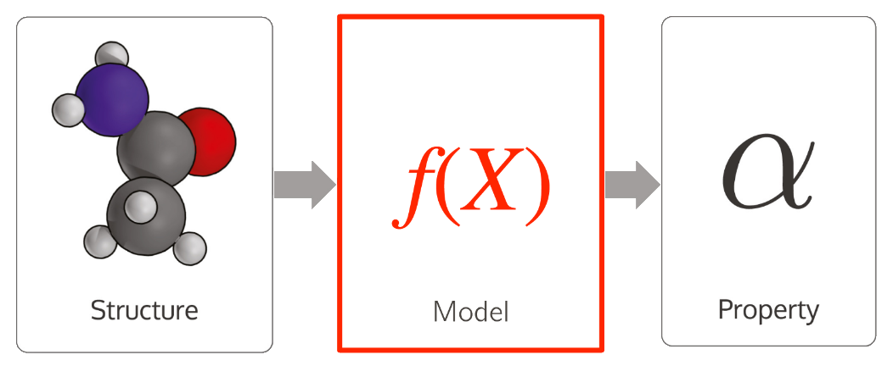
Materials Science ML Workflow
A. Helbling, D.H. Chau, ManimML
Professor Daniel Schwalbe-Koda, Lecture 11

Slide 4

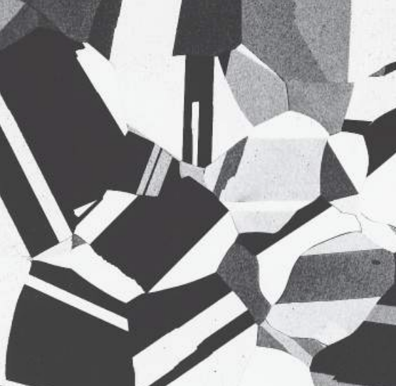
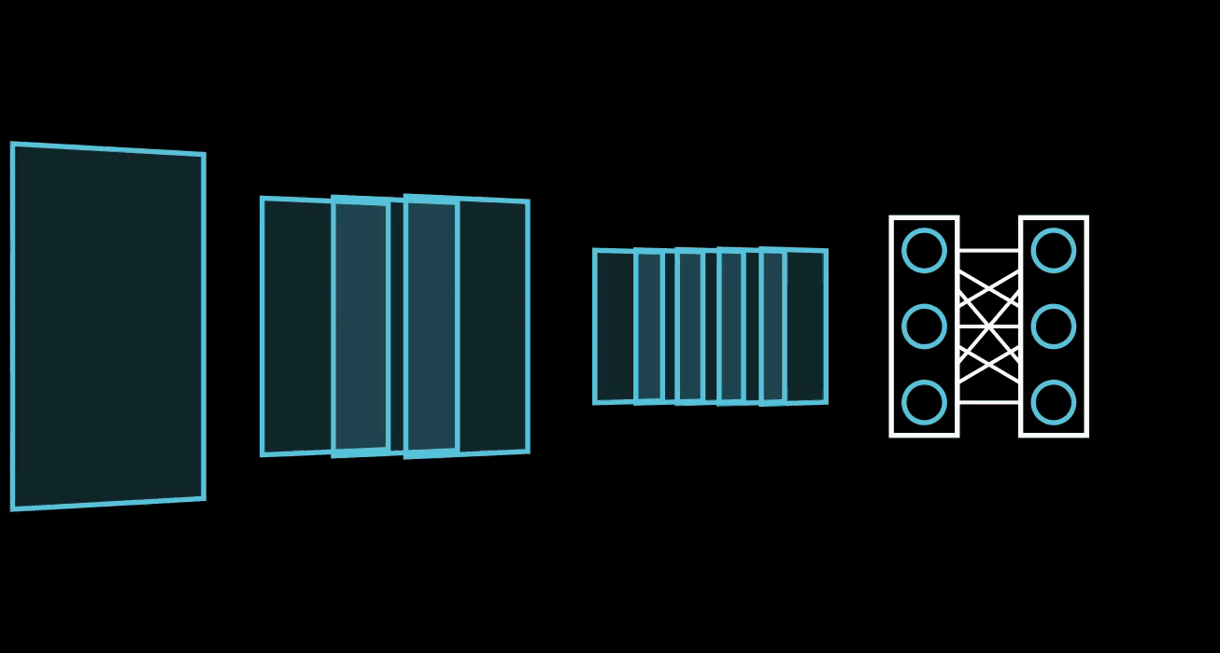
Convolution Neural Network Workflow
CNNs train kernels to learn how to filter features out of grid-like data
Image
Micrographs
A. Helbling, D.H. Chau, ManimML
Professor Daniel Schwalbe-Koda, Lecture 11

Slide 5
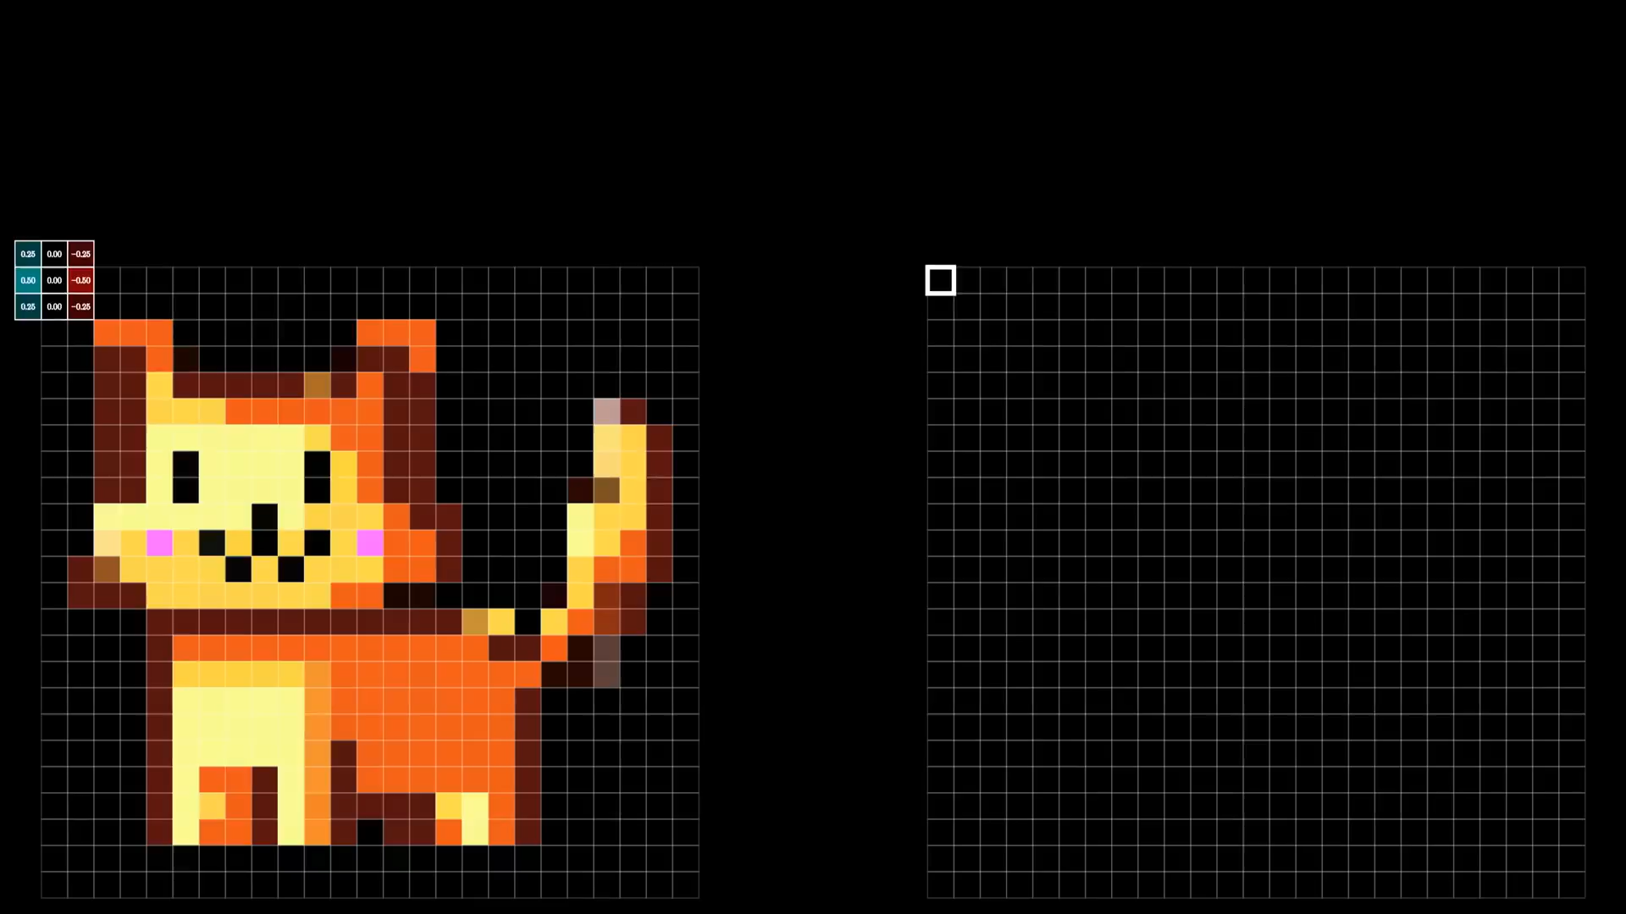

Convolutions $→$ Features
“Edgeness” emerges as a feature of a pixel’s local context
Convolutions aggregate patterns beyond the raw RGB
Grant Sanderson, 3Blue1Brown

Slide 6
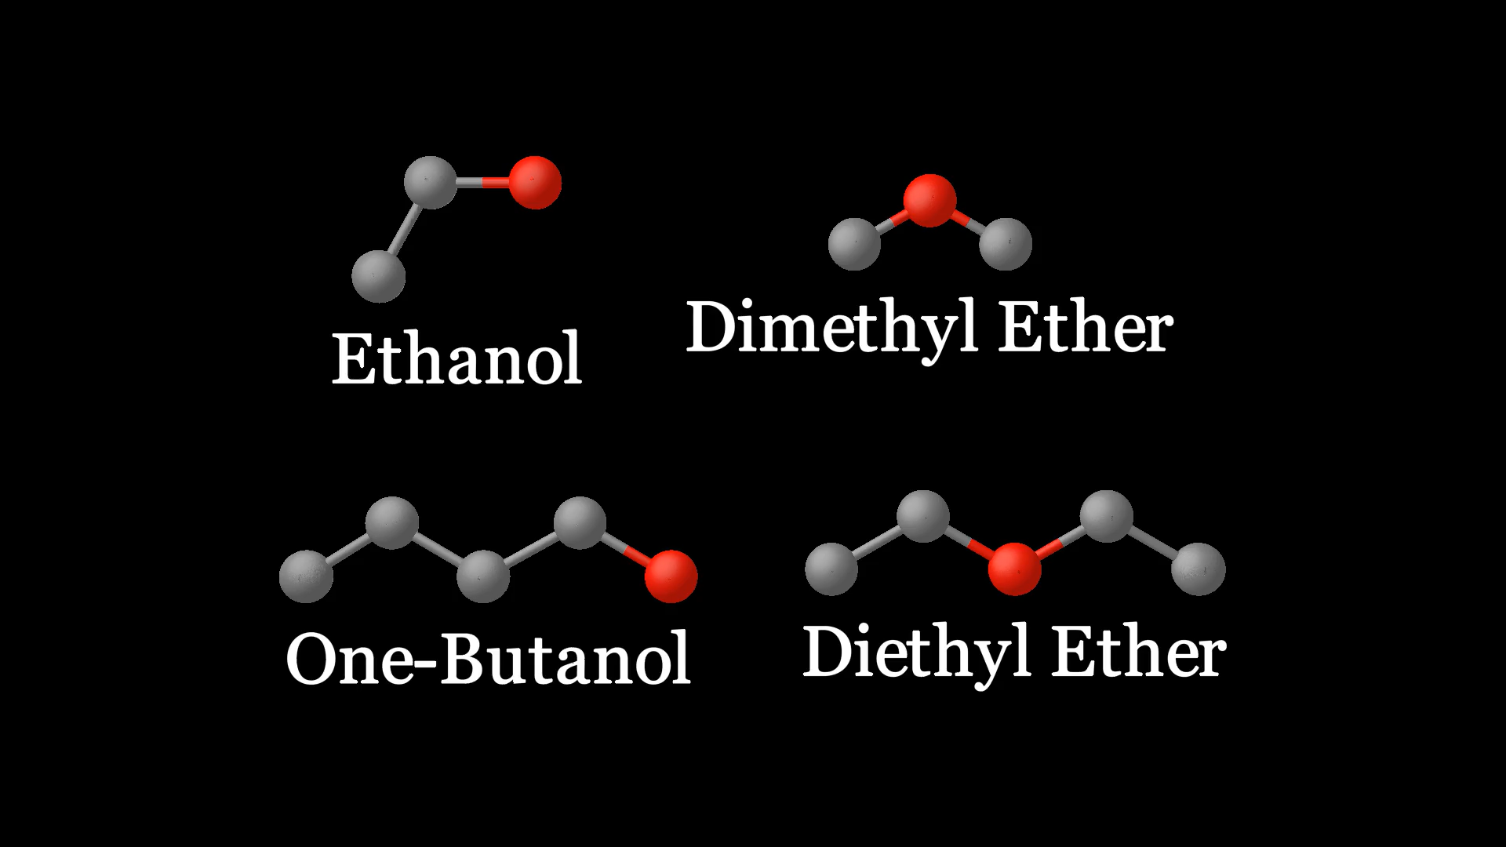
Why Molecular Convolutions?
Why Molecular
?
Connectivity offers a
bonding context
for atomistic features

Slide 7
Convolution Neural Network Workflow
CNNs train kernels to learn how to filter features out of grid-like data
When adjacency is no longer purely spatial, how can we perform convolutions?
Chem Structure?
Micrographs
A. Helbling, D.H. Chau, ManimML
Professor Daniel Schwalbe-Koda, Lecture 11

Slide 8
?
Why Molecular Graphs
Why Molecular
Generalize our notion of adjacency to fit molecular bonding

Slide 9
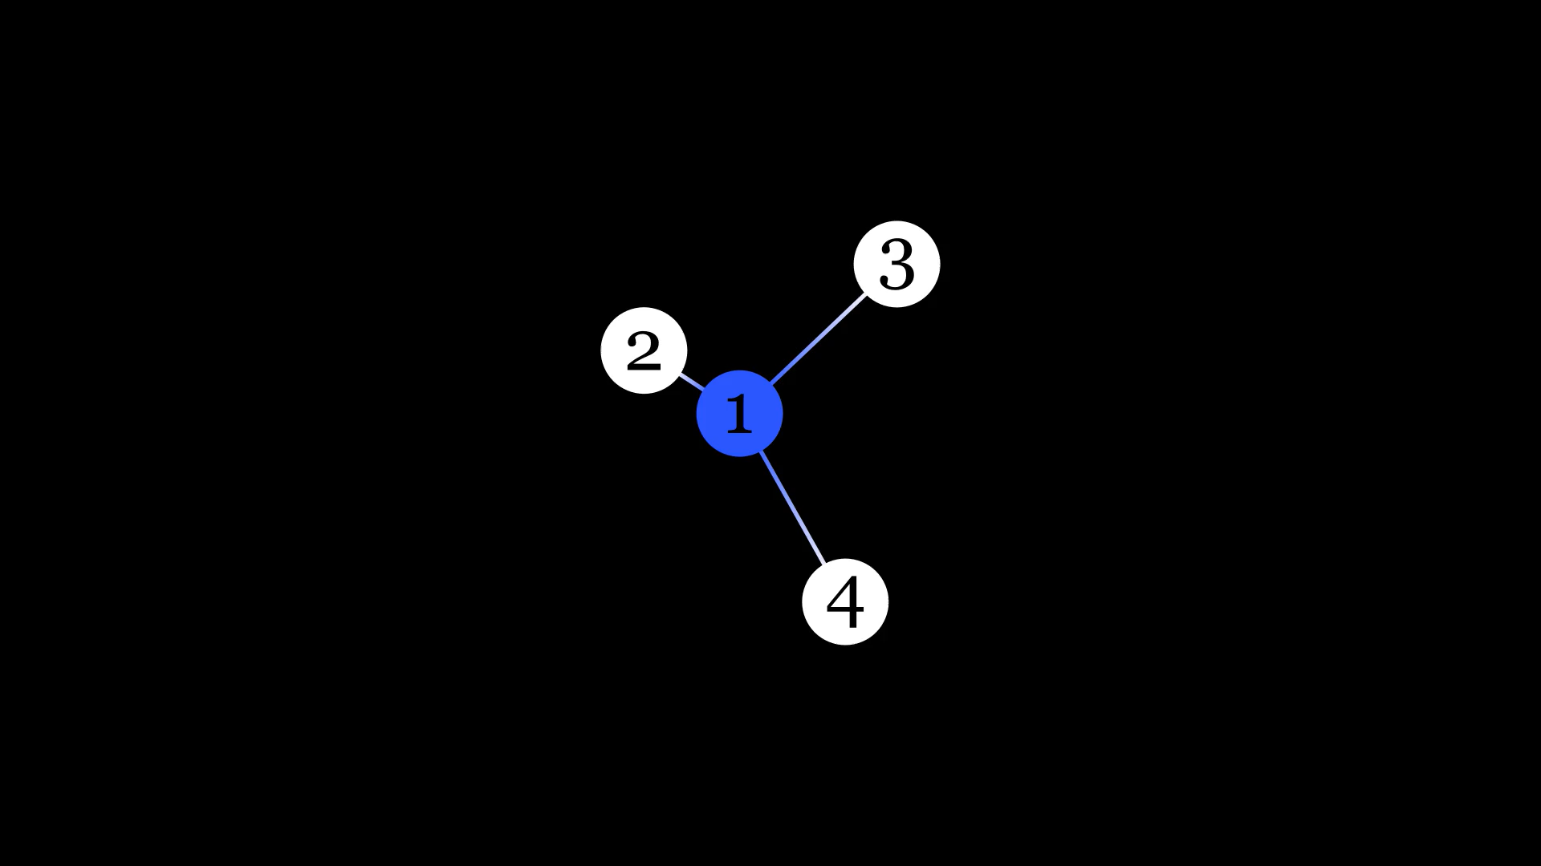
Molecular Graphs Convolutions in Manim
Why Molecular Graphs

Slide 10
Molecular Graphs Convolutions in Manim
Why Molecular Graphs

Slide 11
Molecular Graphs Convolutions in Manim
Manim Code

Slide 12
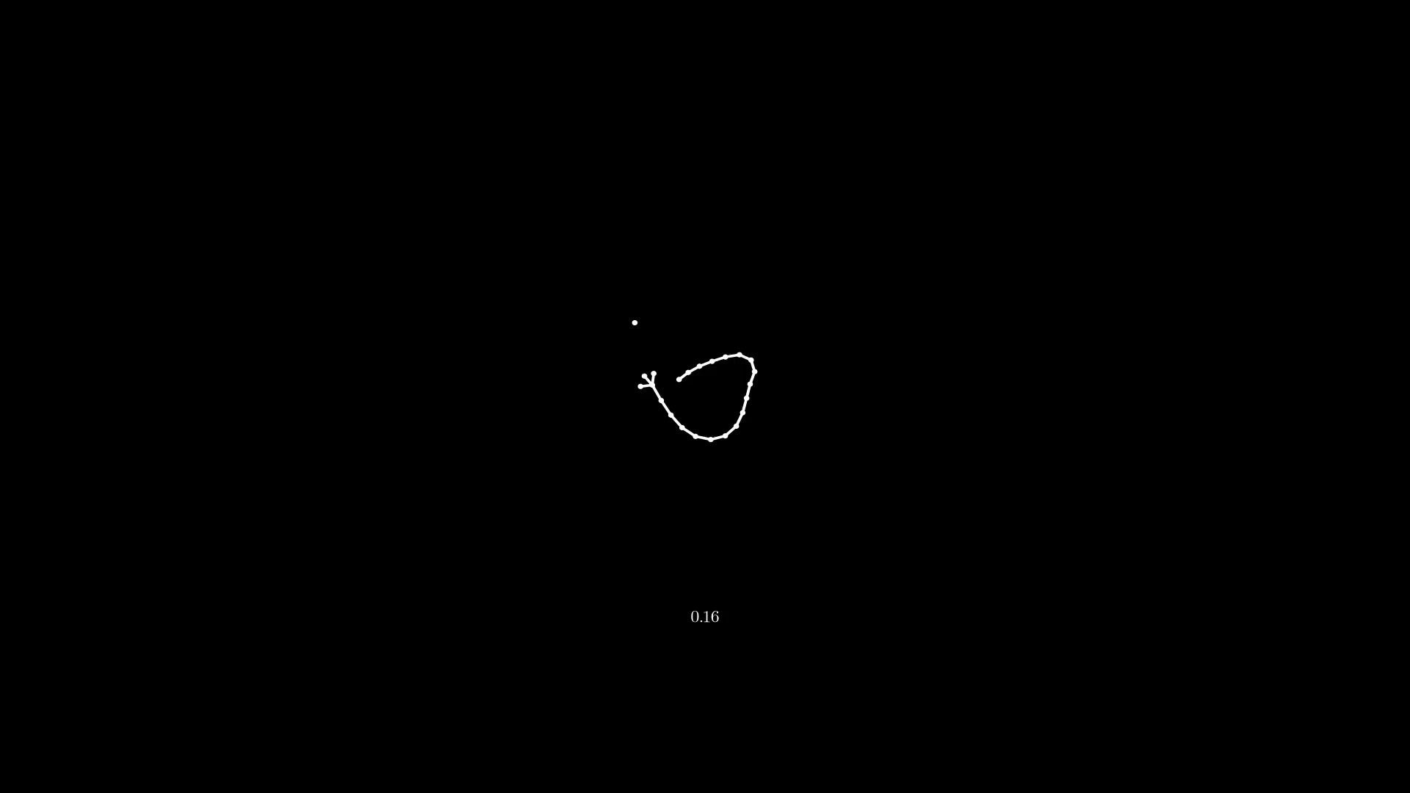
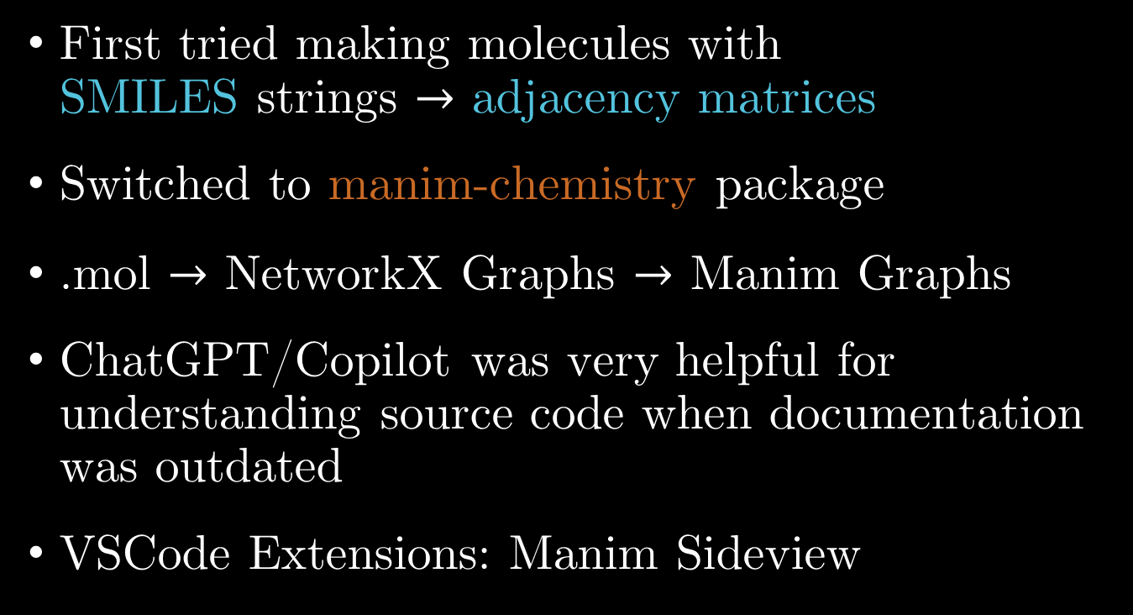
Working with Manim
First tried making molecules with SMILES strings $→$ adjacency matrices
Switched to manim-chemistry package
.mol $→$ NetworkX Graphs $→$ Manim Graphs
ChatGPT/Copilot was very helpful for understanding source code when documentation was outdated
VSCode Extensions: Manim Sideview

Slide 13
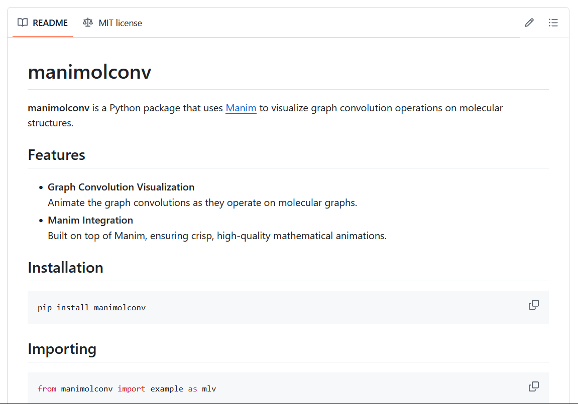
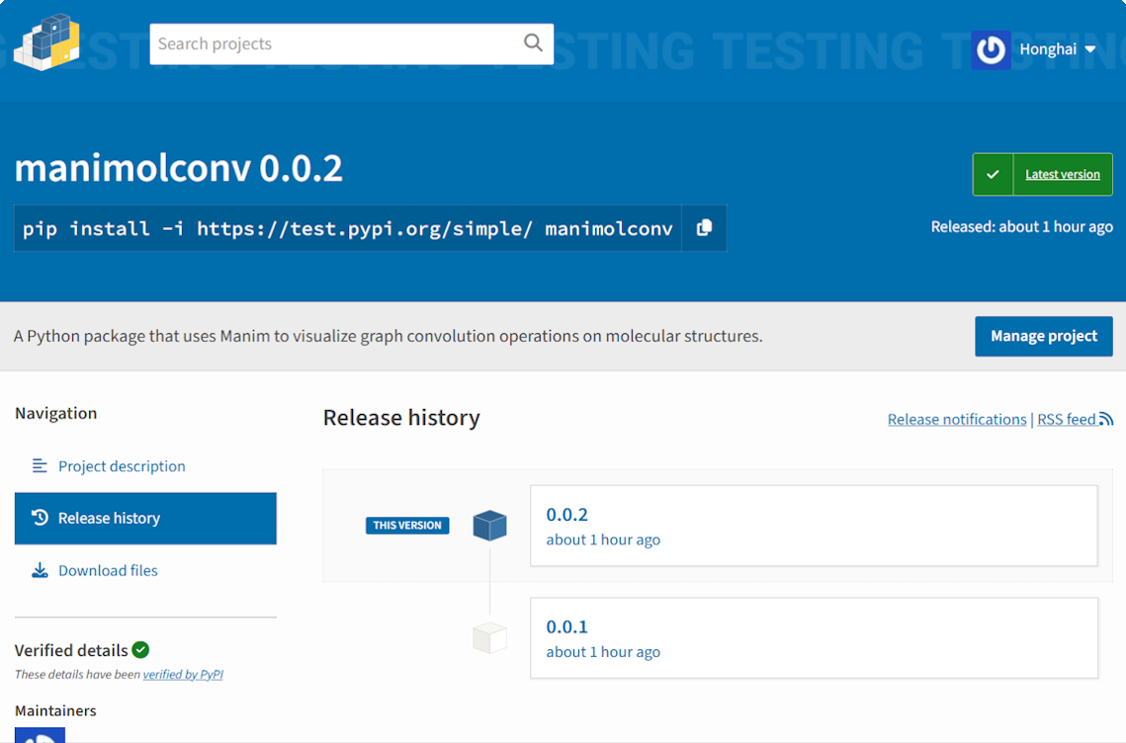
manimolconv Package
Tried turning my functions into a Python package
Important to share and make work accessible
Takeaway: implementation simplicity vs. future flexibility?

Slide 14
Summary
Got a functional Manimation workflow
Successfully visualized convolutions on molecules represented as graphs with labeled with elemental one-hot encodings
Turned my functions into a Python package: manimolconv
Will clean up my repository and package publication
Will make visuals for periodic graphs (crystalline solids)

Slide 15
